Slide 1
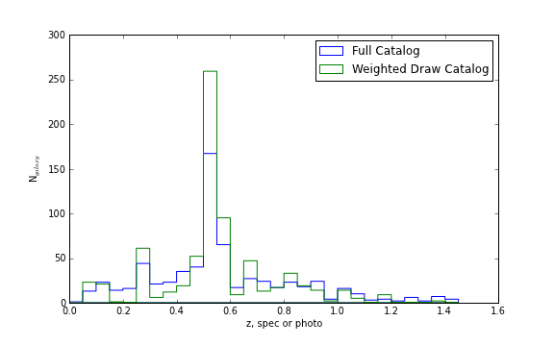
N_{galaxy}
Redshift (spectroscopic if available, otherwise photometric)

Slide 2
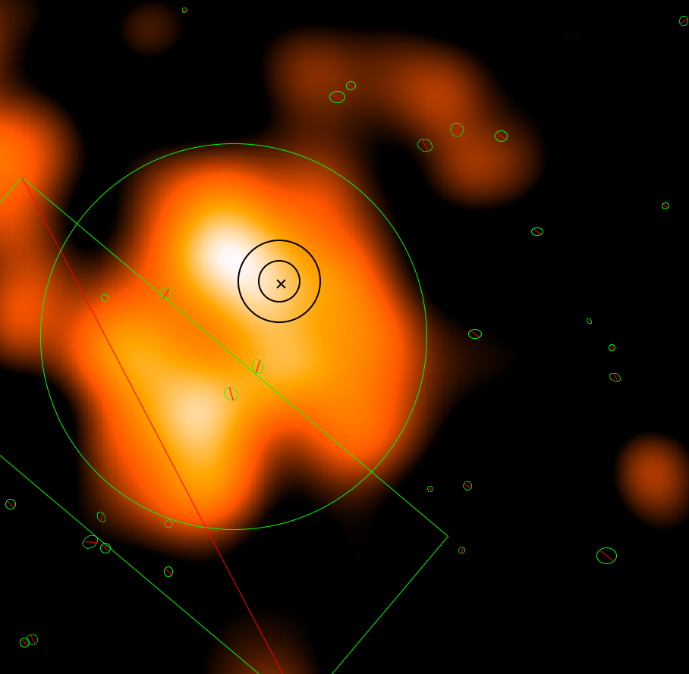
Gas centroid analysis region
X-ray centroid and confidence limits

Slide 3
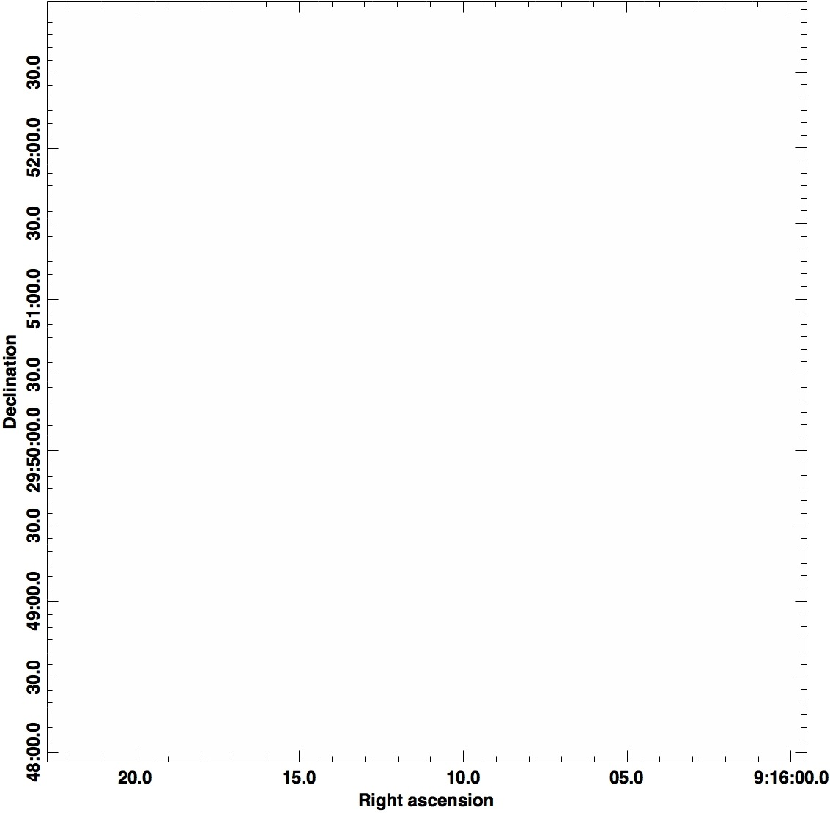
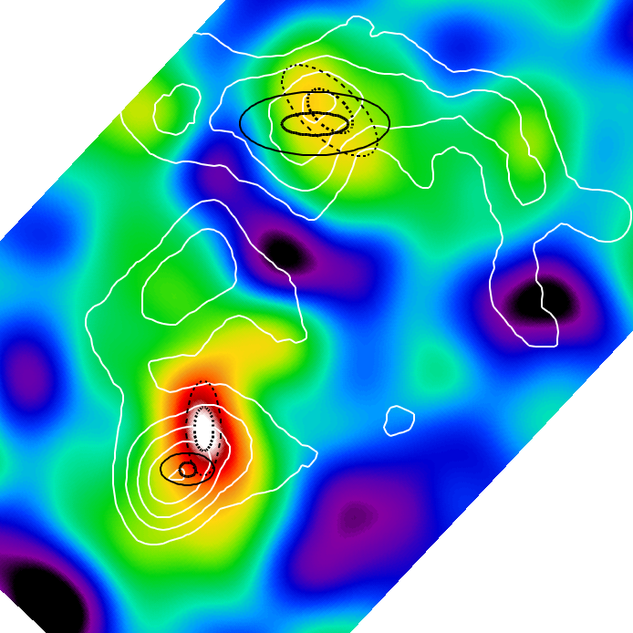
6.5
4.5
2.5
0.5
-1.5
-3.5

Slide 4
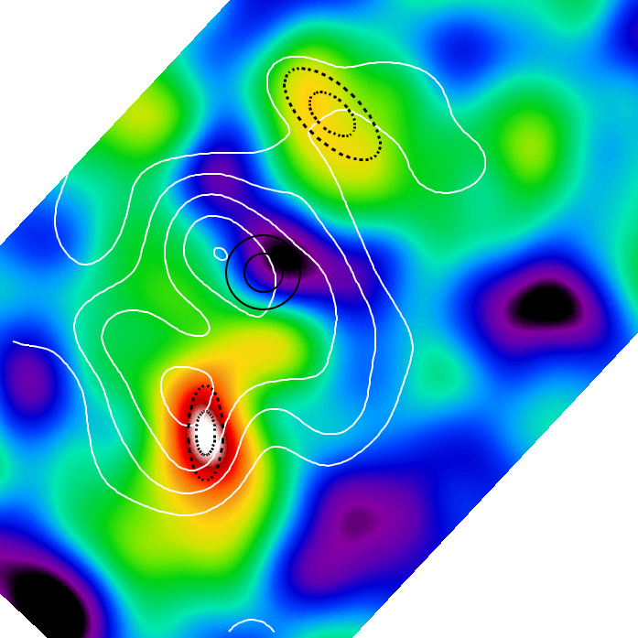
6.5
4.5
2.5
0.5
-1.5
-3.5

Slide 5
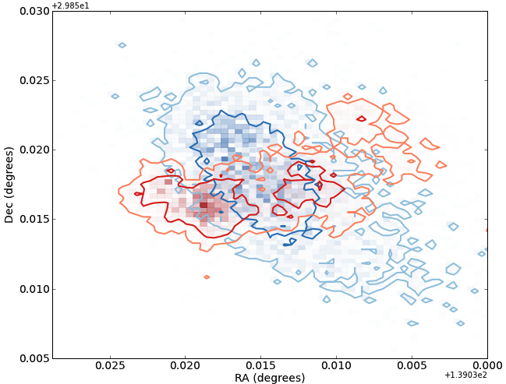
Merger Axis
1st Principal Component Axis
Lensing
Centroid
Galaxy
Centroid
Northern Subcluster

Slide 6
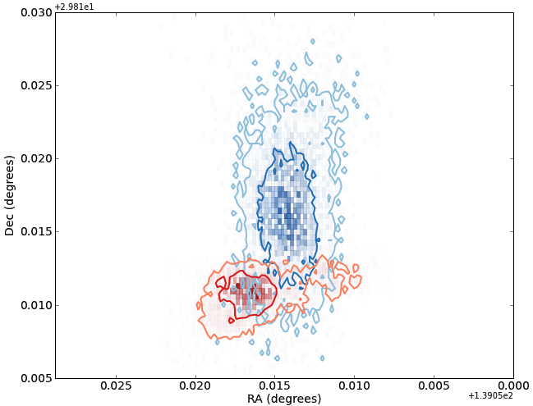
Merger Axis
1st Principal Component Axis
Lensing
Centroid
Galaxy
Centroid
Southern Subcluster

Slide 7
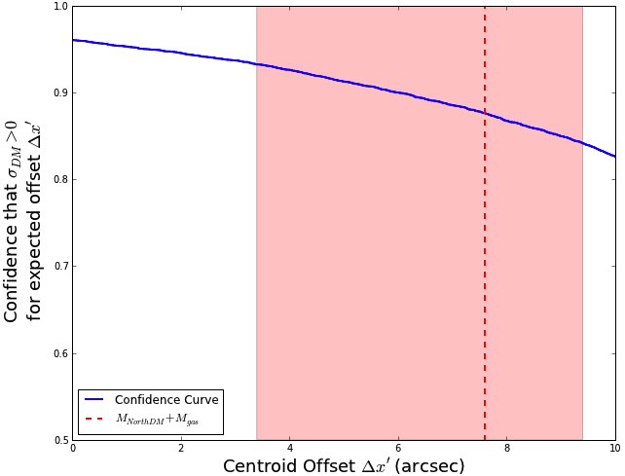
Southern
Subcluster

Slide 8
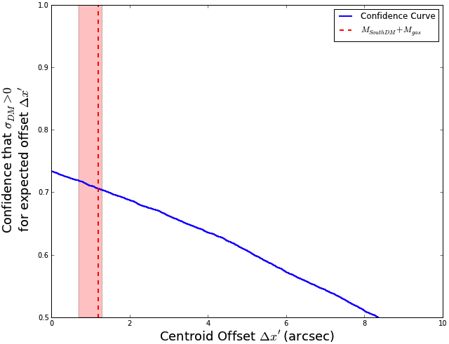
Northern
Subcluster

